Slide 1



Welcome!

Slide 2
Presentation Title
SUBHEAD IF YOU LIKE

Slide 3
Presentation Title
SUBHEAD IF YOU LIKE
Add text here
Add text here

Slide 4
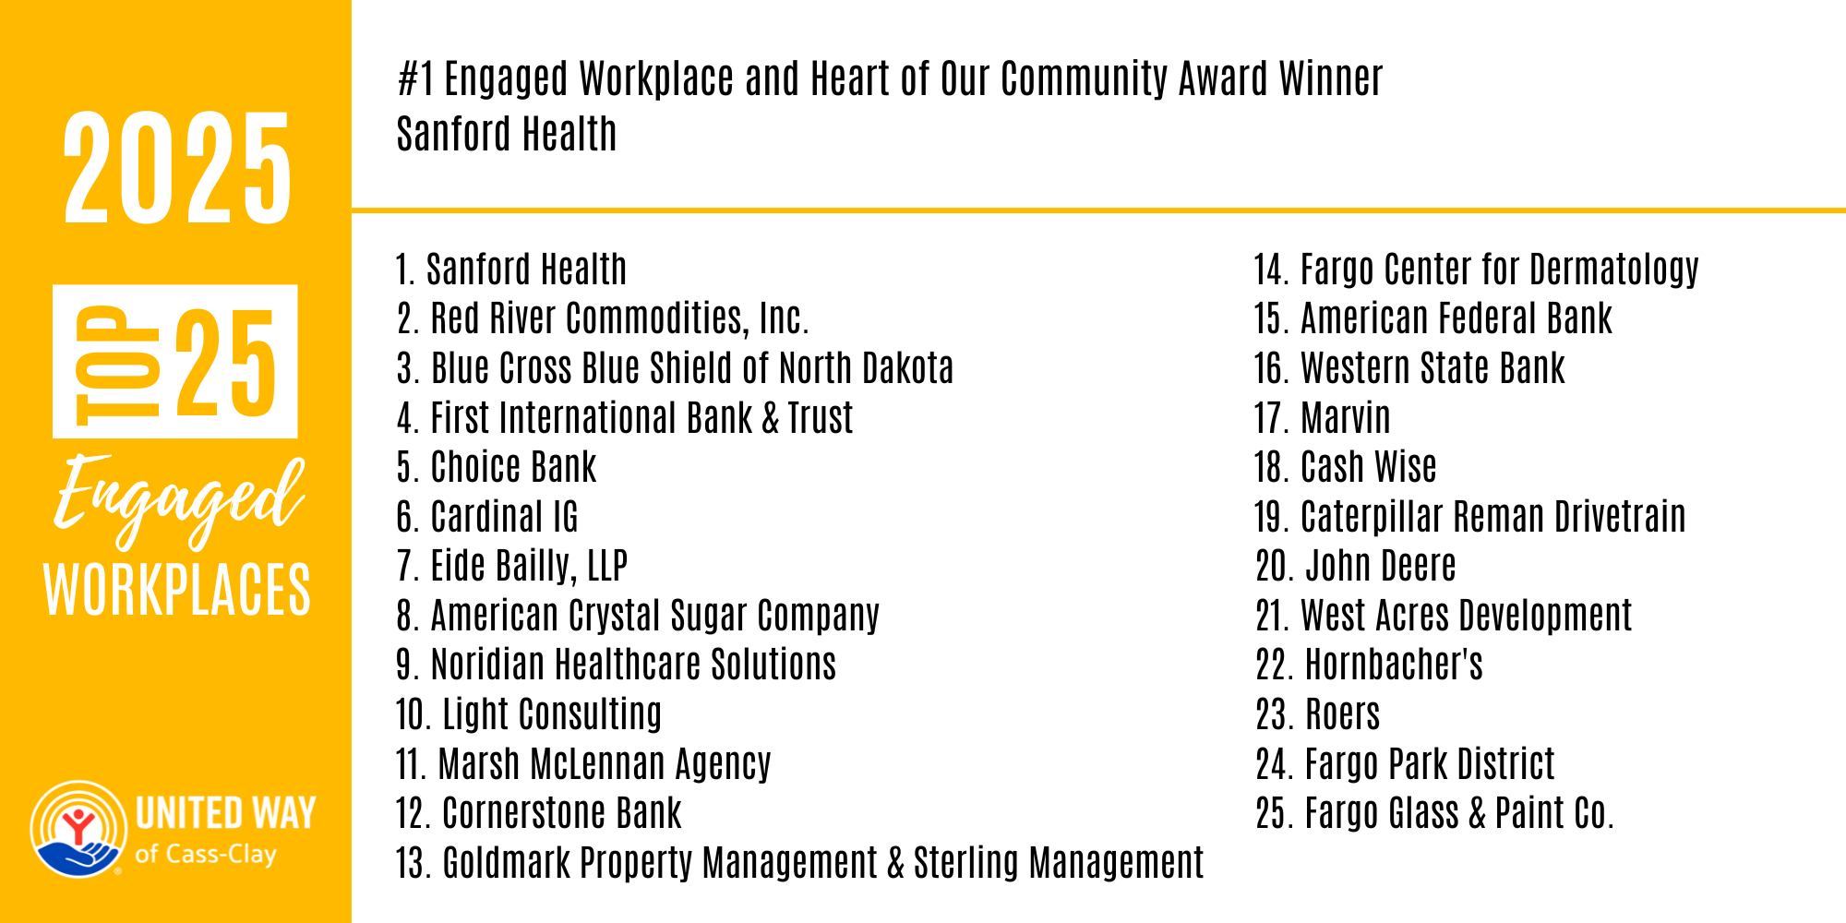

Slide 5
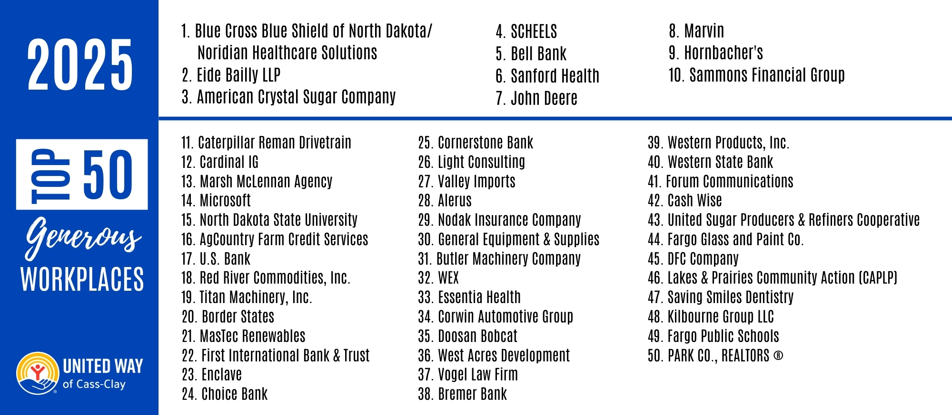

Slide 6

Our Bold Goals
SUBHEAD IF YOU LIKE
Add text here
Add text here

Slide 7
Verified Impact Partners
Afro American Development Association (AADA)
Boys & Girls Clubs of the Red River Valley
CAPLP (Lakes & Prairies Community Action Partnership, Inc.)
Churches United
ESHARA
Fargo Public Schools
FirstLink
FM Coalition to End Homelessness
Folkways
Friends of the Children
Great Plains Food Bank
Immigrant Development Center (IDC)
Jasmin Childcare
Jeremiah Program
Legal Services of North Dakota
Legal Services of Northwest Minnesota
Moorhead Area Public Schools
Nexus PATH Family Healing
Presentation Partners in Housing
Rape & Abuse Crisis Center
Red River Children's Advocacy Center
Rural Enrichment & Counseling Headquarters (REACH)
SENDCAA (Southeastern North Dakota Community Action Agency)
The Village Family Service Center
Vocational Training Center
West Fargo Public Schools
YMCA of Cass and Clay Counties
Youthworks
UMOJA
YWCA Cass Clay

Slide 8
Title
SUBHEAD IF YOU LIKE
Add text here

Slide 10
Best of the Best!
2025 United Way Award Winners
Change Maker Award
Winner: Liz Gronbeck, MasTec Renewables
Nominees: Aaron Hill, Goldmark Commercial Real Estate, Inc., Ann Schneider,
Zerr Berg Architects, Inc., Jae Dewald, Holiday Inn Fargo, Rian Nostrum, NDSU
Humble Hero Award
Winner: Corwin Automotive Group
Nominees: Annie Wood & Meg Kleckner, Cory Steiner, Northern Cass Schools
Flint Group, Mike Arntson, Cardinal IG
Magnetic Marvel Award
Winner: Caterpillar Reman Drivetrain
Blue Cross Blue Shield of North Dakota, Hornbacher’s and Cash Wise, Red River Commodities, Inc., Widmer Roel PC
MVP (Most Valuable Person) Award
Winner: Sanford Health United Way Ambassadors
Brant Niemi, Dacotah Paper, Delta by Marriott Fargo United Way Committee,
Eide Bailly United Way Committee, Titan Machinery, Inc. United Way Committee
Power of Partnership Award
Winner: FM Coalition to End Homelessness
City of Fargo Police Department, Rape and Abuse Crisis Center,Red River Children's Advocacy Center, SCHEELS
Rising Star Award
Winner: Valley Imports
Moorhead Area Public Schools, Town & Country Credit Union, West Acres Development
United Way Philly GOAT Award
#1 Top 50 Generous Workplace
Winner: Blue Cross Blue Shield of North Dakota
United Way Heart of Our Community Award
#1 Top 25 Engaged Workplace
Winner: Sanford Health

Slide 11
Thank You!

